Slide 1



RESTAURANT AND CONSUMER ANALYTICS

Slide 2

RESTAURANT AND CONSUMER ANALYTICS

Slide 3
Introduction
  The Restaurant and Consumer domain focuses on analyzing dining experiences, customer preferences, and restaurant performance.
  Efficient data management helps businesses understand consumer behavior, cuisine popularity, and service quality across locations.
  This project simulates a restaurant recommendation and analysis system using interconnected entities such as consumers, restaurants, cuisines, and ratings.
  It provides hands-on experience in building a structured SQL database and exploring relationships between real-world datasets.
  Students will use SQL queries to extract, analyze, and interpret data for valuable business insights.
  The main goal is to enhance decision-making, improve customer satisfaction, and promote data-driven strategies in the food and hospitality industry.

Slide 4
Problem Statment
The Restaurant and Consumer Data Project focuses on managing and analyzing data related to consumers, restaurants, cuisines, ratings, and online orders. The project aims to organize unstructured data into a structured SQL database to study customer preferences, order patterns, and restaurant performance. Using SQL queries, it helps derive valuable insights that support data-driven decisions, enhance customer satisfaction, and improve operational efficiency in the food and hospitality industry.

Slide 5
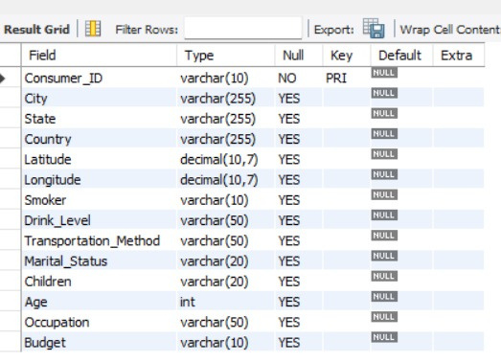
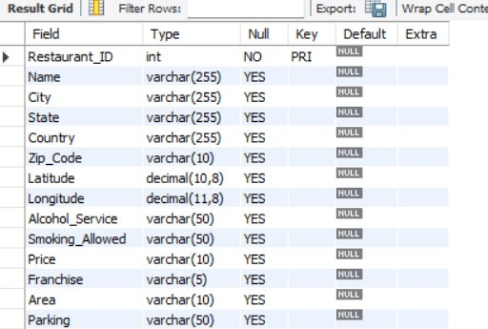
Tables
Restaurants
Consumers

Slide 6
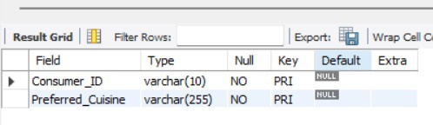
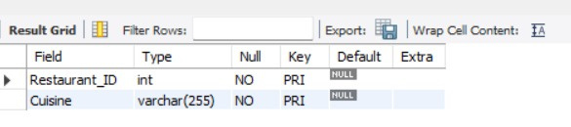
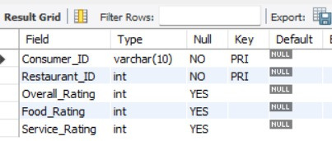
Tables
Restaurant cuisine
Consumer Preferences
Ratings

Slide 7
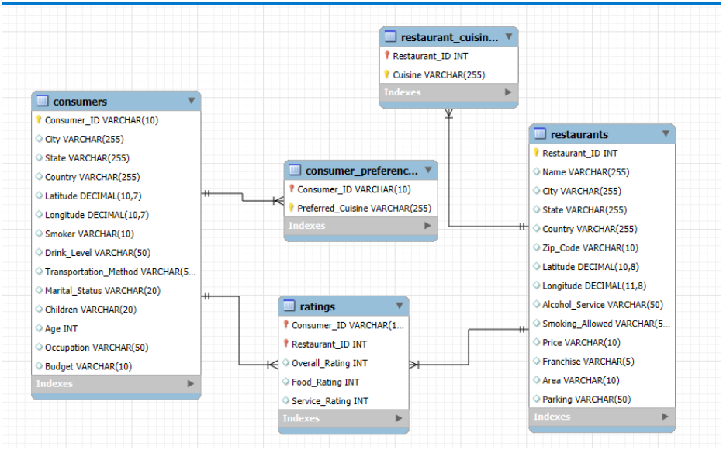
ER Diagram

Slide 8
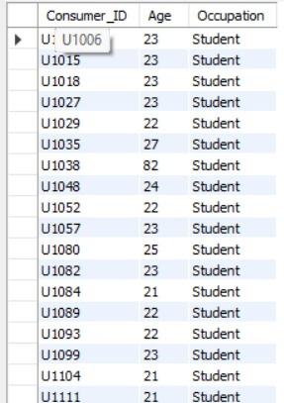

1.Find the Consumer_ID, Age, and Occupation of all consumers who are 'Students' AND are 'Smokers'.

Slide 9
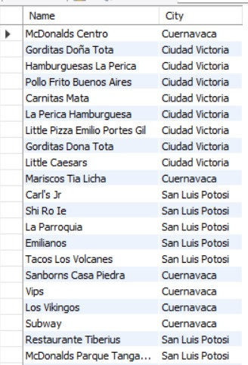

2.Find the names and cities of all restaurants that are part of a 'Franchise'.

Slide 10
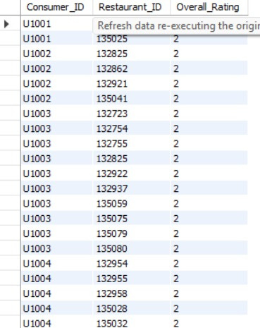

3.List the names and cities of all restaurants that have an Overall_Rating of 2 (Highly Satisfactory) from at least one consumer.

Slide 11
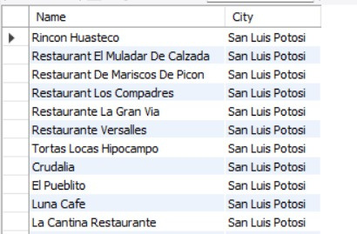
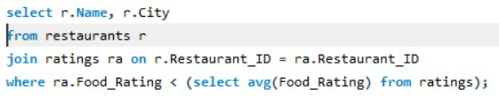
4. List restaurants (Name, City) that have received a Food_Rating lower than the average Food_Rating across all rated restaurants

Slide 12
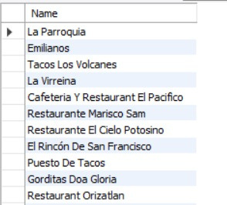
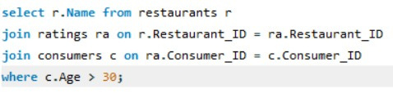
5.List restaurants (Name) that have received ratings from consumers older than 30.

Slide 13
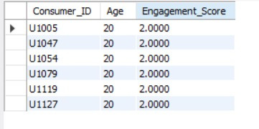

6.We want to categorize consumers by an 'Engagement_Score' which is their Age divided by 10 (integer division). List the Consumer_ID, Age, and this calculated Engagement_Score, but only for consumers whose Engagement_Score would be exactly 2 and who use 'Public'

Slide 14
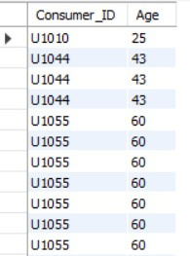

7.Find consumers (Consumer_ID, Age) who are 'Married' and whose Food_Rating for any restaurant is equal to their Service_Rating for that same restaurant, but only consider ratings where the Overall_Rating was 2.

Slide 15
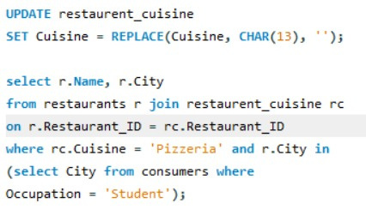
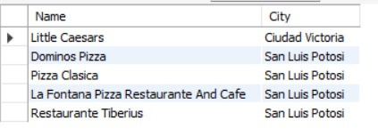
8.List the names and cities of restaurants that serve 'Pizzeria' cuisine and are located in a city where at least one 'Student' consumer lives.

Slide 16
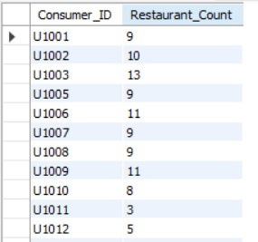
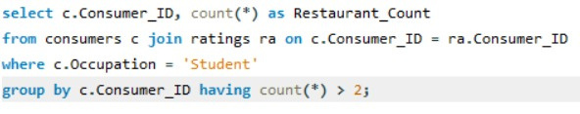

9.List Consumer_IDs and the count of restaurants they've rated, but only for consumers who are 'Students'. Show only students who have rated more than 2 restaurants.

Slide 17
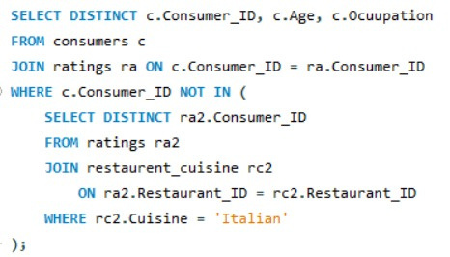
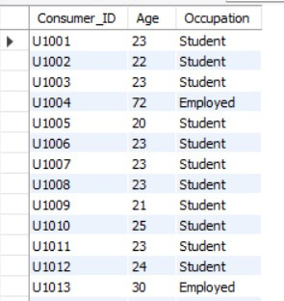
10.Find consumers (Consumer_ID, Age, Occupation) who have rated at least one restaurant but have NOT rated any restaurant that serves 'Italian' cuisine.

Slide 18
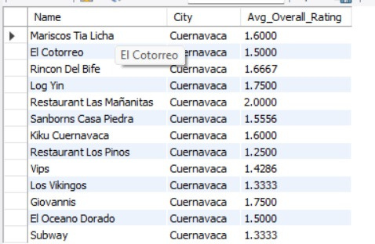
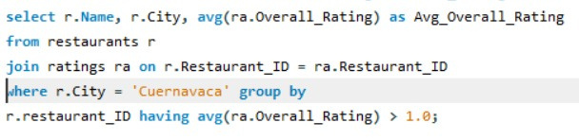
11.For each restaurant, calculate its average Overall_Rating. Then, list the restaurant Name, City, and its calculated average Overall_Rating, but only for restaurants located in 'Cuernavaca' AND whose calculated average Overall_Rating is greater than 1.0.

Slide 19
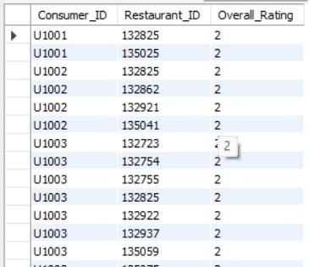

12.Show the Consumer_ID, Restaurant_ID, and Overall_Rating for all ratings where the Overall_Rating was 'Highly Satisfactory' (which corresponds to a value of 2, according to the data dictionary).

Slide 20
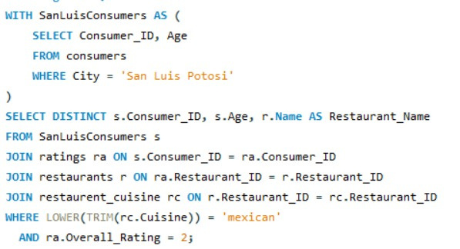
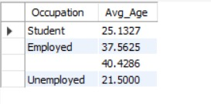
13.Using a CTE, find all consumers who live in 'San Luis Potosi'. Then, list their Consumer_ID, Age, and the Name of any Mexican restaurant they have rated with an Overall_Rating of 2.

Slide 21
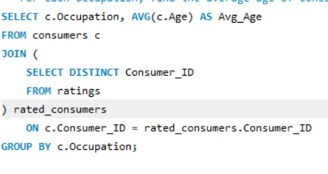
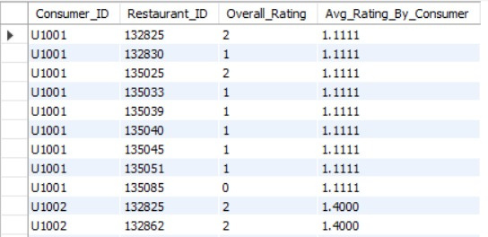
14.For each Occupation, find the average age of consumers. Only consider consumers who have made at least one rating. (Use a derived table to get consumers who have rated).

Slide 22
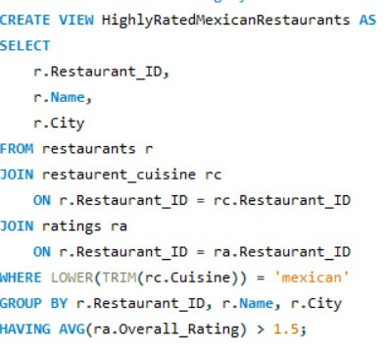
15.Create a VIEW named HighlyRatedMexicanRestaurants that shows the Restaurant_ID, Name, and City of all Mexican restaurants that have an average Overall_Rating greater than 1.5.

Slide 23
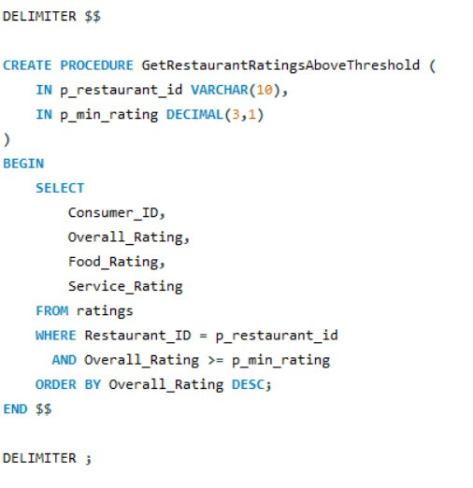
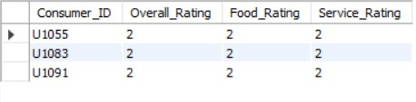
14.Create a stored procedure GetRestaurantRatingsAboveThreshold that accepts a Restaurant_ID and a minimum Overall_Rating as input. It should return the Consumer_ID, Overall_Rating, Food_Rating, and Service_Rating for that restaurant where the Overall_Rating meets or exceeds the threshold.

Slide 24
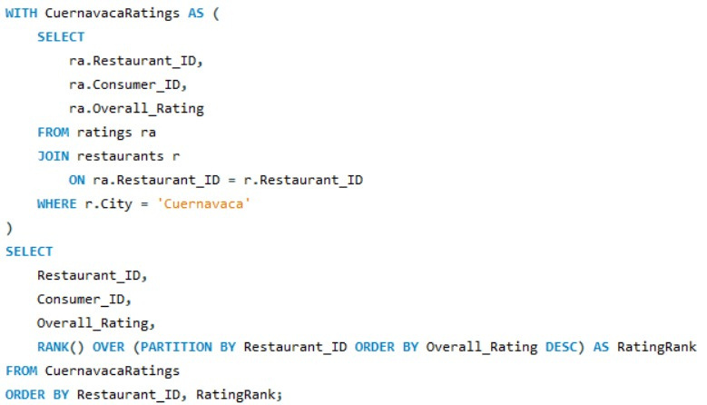
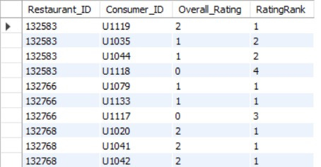
17.Using a CTE to get all ratings for restaurants in 'Cuernavaca', rank these ratings within each restaurant based on Overall_Rating (highest first). Display Restaurant_ID, Consumer_ID, Overall_Rating, and the RatingRank.

Slide 25

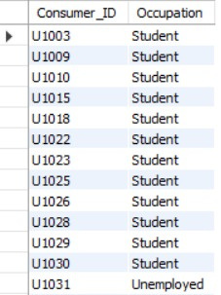
18.Find the Consumer_ID and Occupation of consumers whose preferred cuisine is 'Mexican' and who have given an Overall_Rating of 0 to at least one restaurant (any restaurant).

Slide 26
Thank You
Group members:
A .Nuthana
K.Anusha
K . Dhanlakshmi

